Slide 1
Task Analysis

Slide 2
Task Analysis
Task descriptions are a means for designers to delineate and understand the tasks the user performs
To analyze the underlying rationale and purpose of
what people are doing;
what are they trying to achieve,
why are they trying to achieve it,
how are they going about it?
Task descriptions are written by the designers and can be shared with the client to insure that designers understand the tasks well.
Task descriptions can also be shared with the programmers to help design the software.

Slide 3
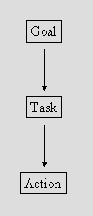
Task Analysis- Decomposition

Slide 4
The difference is ...
Goal - state of the system that a human wants to accomplish.
Recording a TV programme
Ask a friend to record it.
Press ‘Rec’ on the PVR (personal video recorder)
Set the timer using a manual setting
Set the timer using an on-screen TV guide.
Task - activities required, used, or deemed necessary to achieve a goal.
A task will often consist of subtasks where a subtask is a task at a more detailed level of abstraction.
activity may include selecting between alternative actions, performing some actions a number of times and sequencing of actions.
Actions - steps required to complete the task.
press ‘Rec’ on the Recording device

Slide 5
Task Analysis
Task analysis techniques support user-centred design
Informs us (in detail) as to:
how users use existing products
how users may interact with future products
Can be used to:
improve current design
identify potential problems with new design
identify requirements for new design
design training materials and manuals
develop evaluation plans

Slide 6
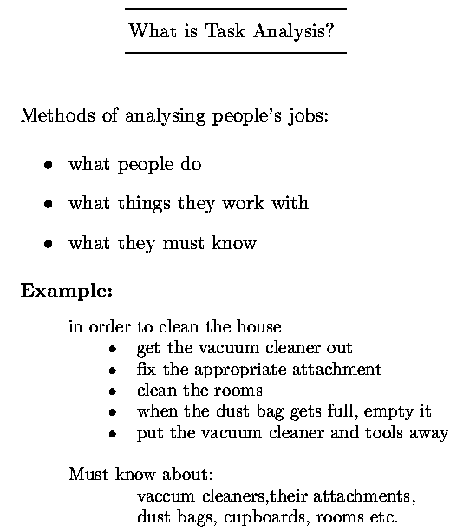

Slide 7
Task Analysis
Task analysis is an important part of systems development, but it is a term that encompasses a number of different views. It is undertaken at different times during systems development for different purposes.

Slide 8
Task Analysis
During the understanding process, for example, the task analysis should aim to be
as independent as possible from the device (or technology)
The aim is to understand the essential nature of the work in order to inform new designs.
During the design and evaluation of future tasks, task analysis focuses on the
achievement of work using a particular technology (i.e. a particular design) and hence is device dependent.

Slide 9
Hierarchical Task Analysis
Two analysis techniques are:
hierarchical task analysis (HTA) and is concerned with the logic of a task (systematic way of a task)
goals, operators, methods, selection rules (GOMS) method, is concerned with a cognitive analysis of tasks, focusing on the procedural knowledge needed to achieve a goal aka (how to do it)
Aims:
describe the actions people do
structure them within task subtask hierarchy
describe order of subtasks
describes existing systems

Slide 10
HTA
is a graphical representation of a task structure based on a structure chart notation.
represent a sequence of tasks, subtasks and actions as a hierarchy
include notational conventions to show whether an action can be repeated a number of times (iteration)
Execution of alternative actions (selection)
HTA can be highly effective in helping people to really understand the structure of tasks – either existing tasks or new, proposed task structures.
Only includes details that are necessary
In a nutshell (user goal, the main tasks associated with achieving that goal are examined, these tasks are subdivided into subtasks-where appropriate)

Slide 11
Procedure for carrying out
Hierarchical Task Analysis
Define the task title/ overall goal (verb-noun pair), e.g. “Use email”, “Print a letter”
The starting point is a set of preconditions (assumptions we make)
Identify the first level of sub-tasks (asking how question)
Should be less than 10
Break down subtasks/subgoals further where needed until reach an appropriate stopping point
Depends on critically and/or complexity
Again, less than 10 task steps for each break-down
Continue adding detail where required.
Describe the order sub-tasks and task steps are performed in plans

Slide 12
Stages of a HTA
1. Starting the analysis
a) Specify the main task.
b) Break down main task into 4-8 subtask, and specify in terms of objectives. Cover the whole area of interest
c) Draw out as layered plans, logically & technically correct. None should be missing.

Slide 13
2. Progressing the analysis
a) Decide on level of detail and stop decomposition. Should be consistent between tasks. Can range from detailed to high level description.
b) Decide if a depth first or breadth first decomposition should be done. Can alternate between the two.
c) Label and number the HTA.

Slide 14
3. Finalizing the analysis.
a) Check that decomposition and numbering is consistent. May produce a written account of the processes.
b) Have a second person look it over. They should know the tasks but not be involved in the analysis.

Slide 15
Textual HTA description
Hierarchy description ... Cleaning house
0. in order to clean the house
1. get the vacuum cleaner out
2. fix the appropriate attachment
3. clean the rooms
3.1. clean the hall
3.2. clean the living rooms
3.3. clean the bedrooms
4. empty the dust bag
5. put vacuum cleaner and attachments away

Slide 16
Plans
... and plans
Plan 0: do 1 - 2 - 3 - 5 in that order. when the dust bag gets full do 4.
Plan 3: do any of 3.1, 3.2 or 3.3 in any order depending on which rooms need cleaning
Note: only the plans denote order

Slide 17
Preconditions
Task Title
1
2
3
4
Sub Task 1
Sub Task 2
Sub Task 3
Sub Task 4
2.1
2.2
2.3
Task Step
Task Step
Task Step
3.1
3.2
3.3
3.4
3.5
Task Step
Task Step
Task Step
Task Step
Task Step

Slide 18
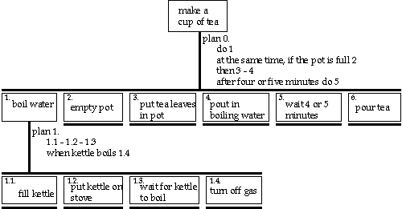
Hierarchical task analysis – graphical view

Slide 19
Refined
HT
A
for
making
tea
Redefined HTA For Making Tea
0.
make
cups
of
tea
plan
0.
do
1
at
the
same
time,
if
the
pot
is
full
2
then
3
-
4
after
4/5
minutes
do
5
1.
2.
3.
4.
wait
4
or
5
5.
boil
water
empty
pot
make
pot
minutes
pour
tea
plan
5.
empty
NO
for
each
5.1
5.2
cups
?
guest
5.3
plan
1.
YES
1.1
-
1.2
-
1.3
-
1.4
when
kettle
boils
1.5
5.1.
5.2.
5.3.
put
milk
fill
cup
do
sugar
in
cup
with
tea
plan
3.
plan
5.3.
3.1
-
3.2
-
3.3
5.3.1
-
if
wanted
5.3.2
3.1.
3.2.
3.3.
5.3.1.
5.3.2.
put
tea
leaves
pour
in
ask
guest
add
sugar
warm
pot
in
pot
boiling
water
about
sugar
to
taste
1.1.
1.2.
1.3.
1.4.
1.5.
fill
kettle
put
kettle
turn
on
and
wait
for
kettle
turn
off
gas
on
stove
light
gas
to
boil
Human{Com
puter
In
teraction,
Pren
tice
Hall
T
ask
Analysis
fl
A.
Dix,
J.
Finla
y
,
G.
Ab
o
wd
and
R.
Beale
c
1993
Chapter
7
(10)

Slide 20
Refining the description
Given initial HTA (textual or diagram)
How to check/improve it?
Some heuristics:
paired actions
e.g., where is `turn on gas'
restructure
e.g., generate task `make pot'
balance
e.g., is `pour tea' simpler than making pot?
generalize
e.g., make one cup or two ... or more

Slide 22
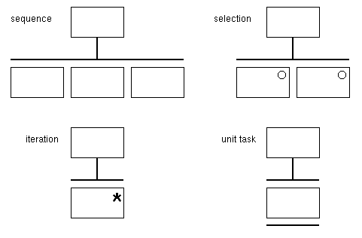
HTA Structure Chart Notation

Slide 23
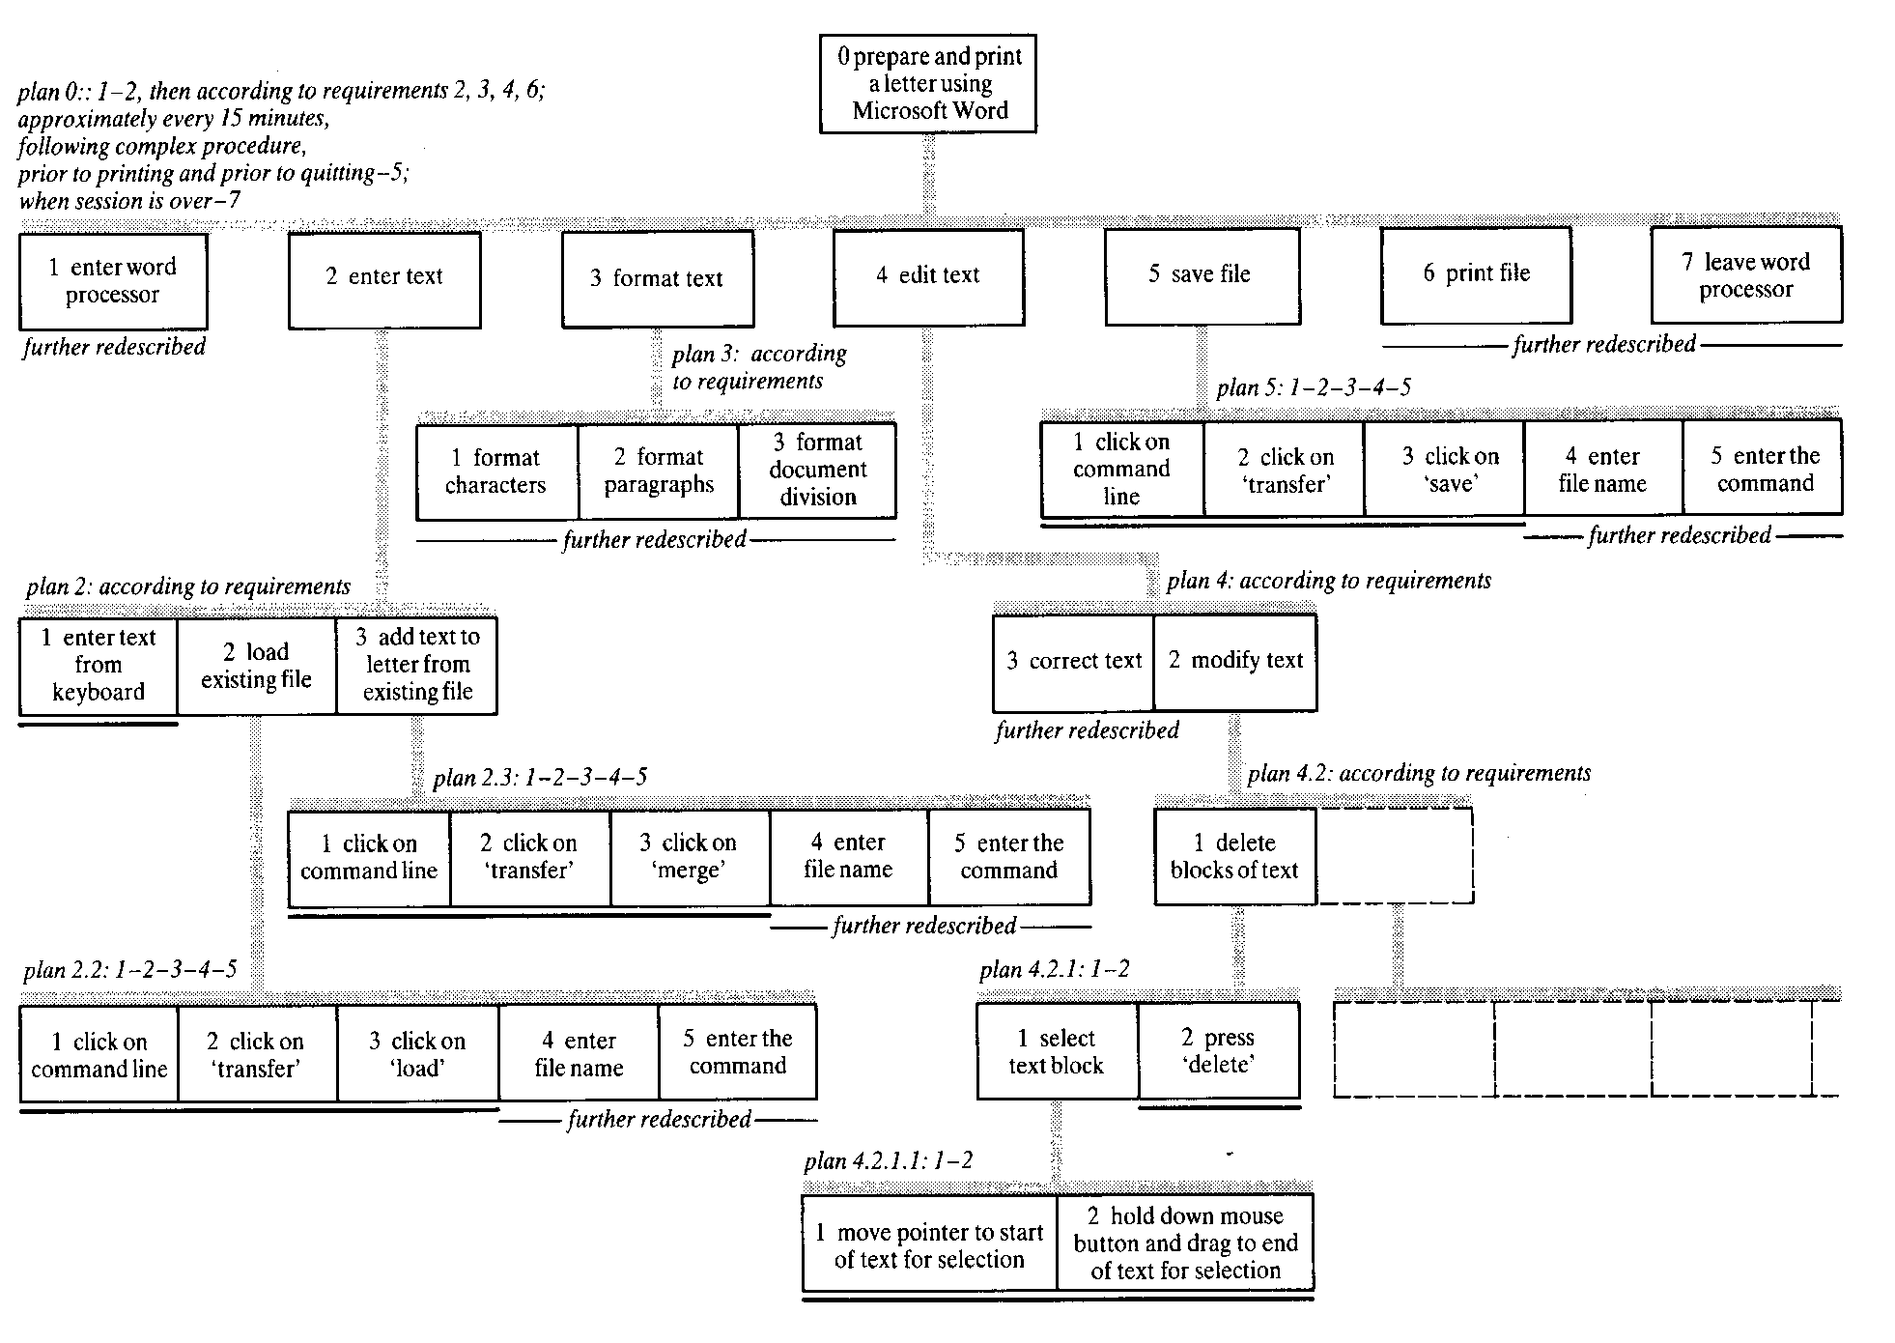

Slide 24
Hierarchical Task Analysis
Task: Invert a portion of an image

Slide 25
Hierarchical Task Analysis
0 Invert a portion of an image
Zoom display to area of interest
Select the Lasso Tool
Select the subregion of the image
Select Inverse from the Image menu

Slide 26
Hierarchical Task Analysis
0 Invert a portion of an image
Zoom display to area of interest
1.1 Select the zoom tool from the toolbox
1.2 Specify the zoom region using the tool
Select the Lasso Tool
Select the subregion of the image
Select Inverse from the Image menu

Slide 27
Zoom in on Face

Slide 28
Hierarchical Task Analysis
0 Invert a portion of an image
1 Zoom display to area of interest
1.1 Select the zoom tool from the toolbox
1.2 Specify the zoom region using the tool
2 Select the Lasso Tool
3 Select the subregion of the image
4 Select Inverse from the Image menu

Slide 29
Select the Lasso Tool

Slide 30
Hierarchical Task Analysis
0 Invert a portion of an image
1 Zoom display to area of interest
1.1 Select the zoom tool from the toolbox
1.2 Specify the zoom region using the tool
2 Select the Lasso Tool
3 Select the subregion of the image
3.1 Point and click around the area of interest (“produces a rubber band”)
3.2 Adjust the “rubber band” to accurately select the region
4 Select Invert from the Image menu

Slide 31
Select the subregion

Slide 32
Hierarchical Task Analysis
0 Invert a portion of an image
1 Zoom display to area of interest
1.1 Select the zoom tool from the toolbox
1.2 Specify the zoom region using the tool
2 Select the Lasso Tool
3 Select the subregion of the image
3.1 Point and click around the area of interest (“produces a rubber band”)
3.2 Adjust the “rubber band” to accurately select the region
4 Select Invert from the Image menu

Slide 34
Apply invert operation

Slide 35
“zoom” has been the default tool in Adobe Photoshop
How/Why would they have decided to choose “zoom” as the default tool?

Slide 36
Hierarchical task analysis – textual representation
HTA can also be written as a list like this:
0. to clean house
1. get vacuum cleaner
2. clean rooms
2.1 clean hall
2.2 clean living rooms
2.3 clean bedrooms etc
3. empty dust bag
4. put vacuum cleaner away
Plan 0: do 1,2,4
when dust bag full, do 3
Plan 2: do any of 2.1, 2.2, 2.3 in any order depending on which rooms need cleaning.

Slide 37
An example of HTA for a Microwave Oven
What is the overall goal?
“Cook food!”
How is this done?
Prepare meal
Put meal in oven
Select programme
Listen for bell to ring
Remove meal

Slide 38
An example of HTA for a Microwave Oven
Selecting a programme - How is this done?
Set to autosensor
Set to defrost
Set timer to cook
What are the rules that influence the order in which tasks/subtasks take place? (the plans)…..

Slide 39
Task Analysis – Critical Thinking
Some requirements that might have ‘emerged’ from carrying out this Task analysis:
The need for a distinctive, but not annoying, bell sound
The need for an easily accessible mechanism for opening the door
The need for a highly learnable (guessable) means of selecting a programme

Slide 40
Assumptions about the interface
Must be made to fulfill the system requirements.
Very true if we are describing how users behave on an existing system.
Should not be made when we are designing a new system.
Don’t limit our options before we start.

Slide 41
GOMS
Goals, Operators, Methods, & Selection Rules

Slide 42
GOMS – Most Popular AA Technique
GOMS stands for (?)
Goals: person trying to do at each step
Operators: what a person do & how long does each of them take
Methods: how does the person do the task
Selection rules: how do I decide at each step what to do
Input: detailed description of UI/task(s)
How fast exe is, how well do users learn the system, where is the bottleneck
Output: qualitative & quantitative measures
To create a predictive model of a task, better understand the usability of systems, create satisfying user interface
Notes:
Different step, different method, therefore diff task

Slide 43
Quick Example
Goal (the big picture, goal, sub-goals, sub-sub-goals)
go from hotel to the airport, travel from Boston to NY
Methods (or subgoals)?
walk, take bus, take taxi, rent car, take train
Operators (or specific actions)
locate bus stop; wait for bus; get on the bus; finding a address by entering st add, or by entering point of interest
Selection rules (choosing among methods)?
Example: Walking is cheaper, but tiring and slow
Example: Taking a bus is complicated abroad

Slide 44

Goals
Something the user wants to achieve
Examples?
go to airport
delete file
create directory
Hierarchical structure
may require many subgoals

Slide 45
GOMS Output Used To
Ensure frequent goals achieved quickly
Making hierarchy is often the value
functionality coverage & consistency
does UI contain needed functions?
consistency: are similar tasks performed similarly?
operator sequence
in what order are individual operations done?

Slide 46
How to do GOMS Analysis
Generate task description
pick high-level user Goal
write Method for accomplishing Goal - may invoke subgoals
write Methods for subgoals
this is recursive
stops when Operators are reached
Evaluate description of task
Apply results to UI
Iterate!

Slide 47
Disadvantages of GOMS
Not as easy as HE, guidelines, etc.
Takes lots of time, skill, & effort
Experts without error
Does not address several UI issues,
readability, memorability of icons, commands
Does not take into account mistakes
Does not consider users who are new, assumes people know what to do

Slide 48
GOMS Family of Models
MHP: Model Human Processor – original GOMS
KLM: Keystroke-Level Model (simplified version of MHP-can be used for any thing)
CPM-GOMS: Critical Path Method-GOMS
CogTool: Storyboard based calculation method
KLM for phones: special version for cell phones an other apps

Slide 49
GOMS: Keystroke-Level Model (KLM)
Simplest GOMS technique
The basis for all other GOMS techniques
Predicts execution time
Requires analyst-supplied methods
Assumption 1: that the task is a routine cognitive activity or skill can be decomposed into a serial sequence of basic cognitive operations and motor activities
Assumption 2: there are no mistakes-unrealistic
K: A keystroke (280 msec/ 0.28s)
P: Pointing to a target on a small display/ point w/ mouse (1100 msec/ 1.10s)
H: Moving hands from the keyboard to a mouse/home to/from keyboard or other device (400 msec/ 0.40s)
M: A single mental operator/mentally prepare (1350 msec/1.35s)
S: Scan (find coordinates – a cell in spreadsheet) (2.29s)
Notes:
Assumption 1: the person basically knowns what to do
Assumption 2: since we are analyzing, there may be some part that has errors, BUT if a person does this…, if they make a mistake at that step, what are the steps they go through, and what steps they take to correct it?
time for correct steps, time for error, error probability = xyz, mean time + avg weighted time – but tedious if too many errors

Slide 50

KLM Example
Top-level Goal: Edit Manuscript (move “quick brown” to before “fox”)
Subgoal: Highlight text
Operators: Move-mouse
Click mouse-button
Type characters (keyboard shortcuts)
Methods: 1. Delete-word-and-retype (retype method)
2. Cut-and-paste-using-keyboard-shortcuts (shortcuts method)
3. Cut-and-paste-using menus (menus method)
Selection Rules: If the text to be moved is one or two characters long, use retype method
Else, if remember shortcuts, use shortcuts method Else, use the menus method

Slide 51


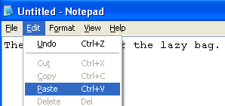
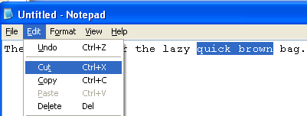
Method Used
Cut-and-paste-using-menus
Description | Operator | Duration (sec)
Mentally Prepare | M | 1.35
Move cursor to “quick” | P | 1.10
Double-click mouse button | K | 0.40
Move cursor to “brown” | P | 1.10
Shift-click mouse button | K | 0.40
Mentally Prepare | M | 1.35
Move cursor to Edit Menu | P | 1.10
Click mouse button | K | 0.20
Move cursor to Cut menu item | P | 1.10
Click mouse button | K | 0.20
Mentally Prepare | M | 1.35
Move cursor to before “fox” | P | 1.10
Click mouse button | K | 0.20
Mentally Prepare | M | 1.35
Move cursor to Edit menu | P | 1.10
Click mouse button | K | 0.20
Move cursor to Paste menu item | P | 1.10
Click mouse button | K | 0.20
TOTAL PREDICTED TIME |  | 14.90
1
2
M=1.35
P=1.10
K=0.20
3
4
5

Slide 52
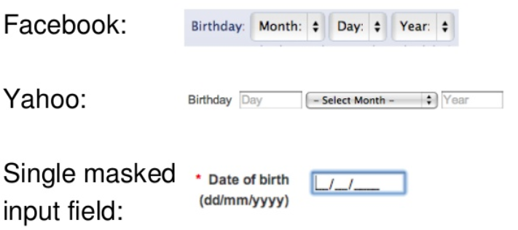
What’s your pet way of collecting date of birth from the following three methods?_______________
Use KLM-GOMS to see if your method is the fastest or not?
Use K= 0.28s, P=1.1s, H=0.40s, M=1.35s

Slide 53
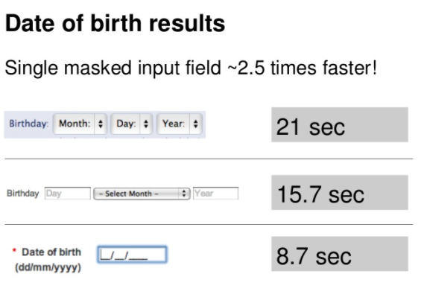
https://www.slideshare.net/AndrewUX/goms-analysis-on-the-back-of-the-envelope

Slide 54
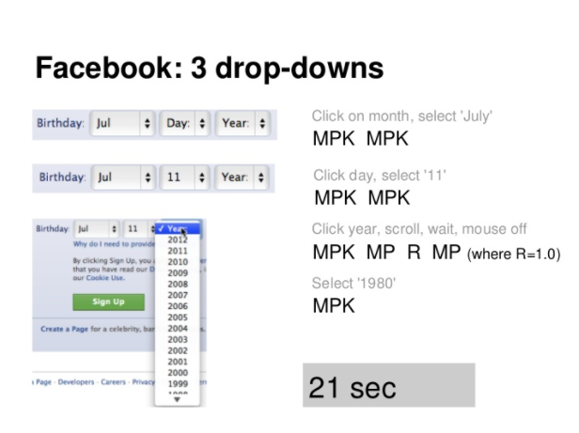

Slide 55
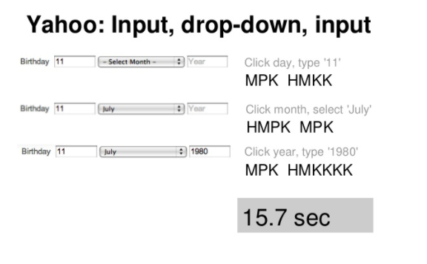

Slide 56
